Slide 1

RIZVI COLLEGE OF ENGINEERING
AND
COMPUTER SOCIETY OF INDIA
DATA SCIENCE & python

Slide 2
Content
Day 01:
Session 1:- Introduction to python
Conducted By: Prof. Mohd Ashfaque Shaikh
Prof. Sonalii Suryawanshi
Session 2:- Packages and Modules for Scientific Calculations
Conducted By: Prof. Mohd Ashfaque Shaikh
Prof. Sonalii Suryawanshi
Day 02:
Session 1: Statistical Data Analysis for Data Science
Session 2: Machine Learning
Conducted By: Prof. Mrs Mukesh Yadav

Slide 3
Day 01: Course Outline
Python Installation
interactive "shell"
basic types: numbers, strings,variables
container types: lists, dictionaries, tuples
control structures
functions & procedures
Modules
Numpy
Pandas
Matplot

Slide 4
What is Python..?
Python is an interpreted, object- oriented, high-level programming language with dynamic semantics.
Primarily used for web and app development
Provides dynamic typing and dynamic binding

Slide 5
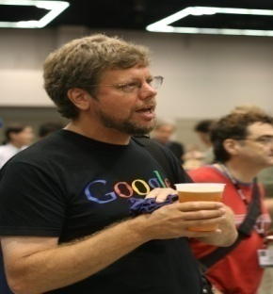
History
Invented in Netherlands, early 90’s by Guido Van Rossum.
Python was concieved in the late 1980.
Guido Van Rossum is fan of ‘Monty Python flying Circus’ this is famous tv show in Netherlands.
Named after Monty Python.
Open source from beginning.

Slide 6
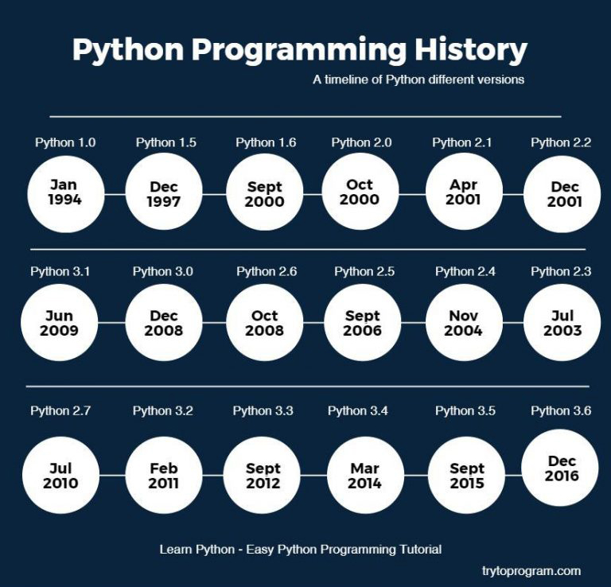
Python Versions

Slide 7
Scope of python
Science
System Administration
Web application development
Testing Scripts

Slide 8
Who uses python today
Data Scientists - probably the largest portion of python community
Game Developers - ( pygame, ren’py …)
Educators - since it is readable and easy to learn
Network Admins/Systems Administrators/Security Testers - makes a good alternative to bash scripting.
Web Developers - django, flask, etc…
IOT Developers - Raspberry PI, serial communication
Python is used by Intel, IBM, NASA, Pixar, JP Morgan Chase, and a number of other major companies.

Slide 9
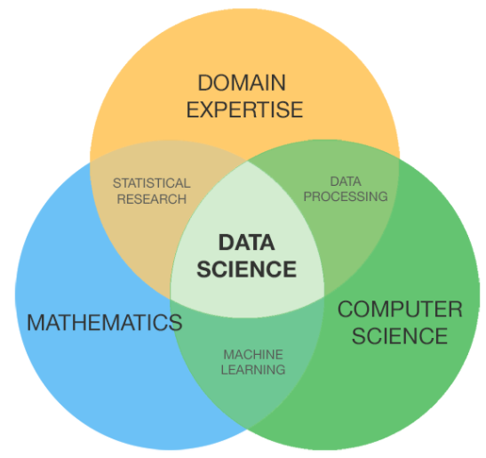
What is Data Science

Slide 10
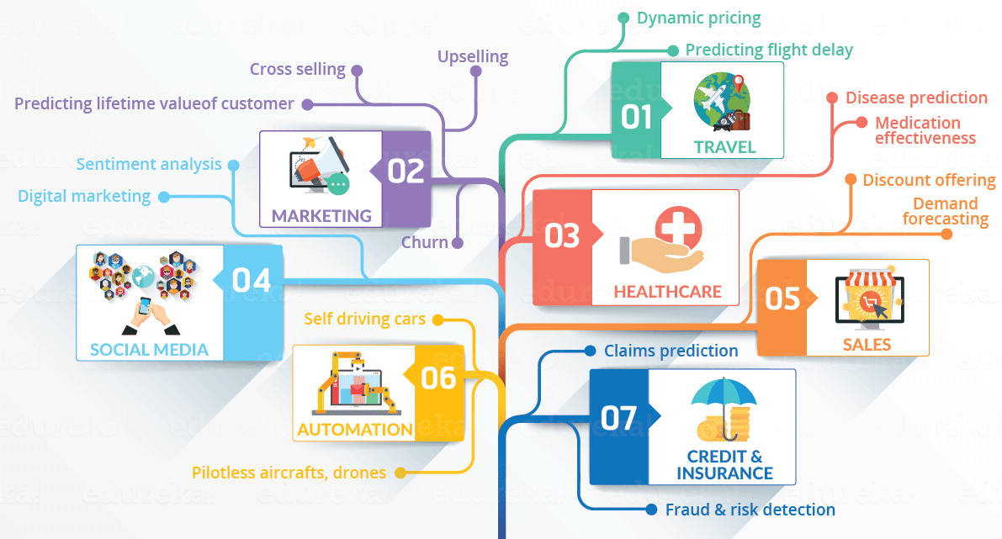
Why Data Science
Making Decision for businesses
Forecasting Weather
Studying Protein structure in biology
Designing a marketing campaign etc

Slide 11
Why Data Science using Python..?
Simple and easy to learn
Cross platform
Executes Faster
Excellent Memory management capability
Large collection of libraries and packages

Slide 12
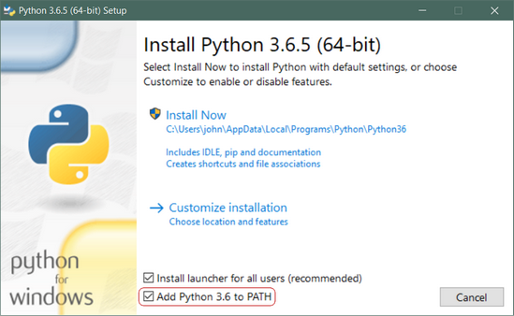
Download and Installation of Python
https://www.python.org/

Slide 13
Thank You

